Slide 1
Test Planning and Management

Slide 2
Test Plan
is a detailed document that outlines the test strategy, Testing objectives, resources ) required for testing, test schedule, Test Estimation and test deliverables.

Slide 3
Benefits of Test Plan
helps us determine the effort needed to validate the quality of the application under test
Help people outside the test team such as developers, business managers, customers understand the details of testing.
Test Plan guides our thinking.
Important aspects like test estimation, test scope, Test Strategy are documented in Test Plan, so it can be reviewed by Management Team and re-used for other projects.

Slide 4
steps for a test plan
Analyze the product
Design the Test Strategy
Define the Test Objectives
Define Test Criteria
Resource Planning
Plan Test Environment
Schedule & Estimation
Determine Test Deliverables

Slide 5
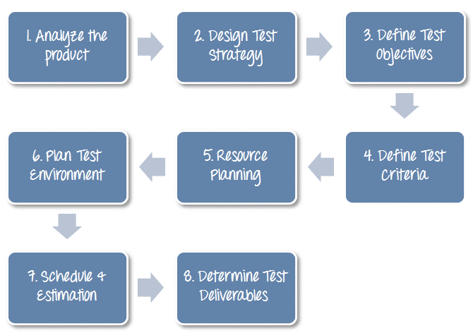
Steps for IEEE test plan

Slide 6
Analyze the product- Banking website product
Who will use the website?
What is it used for?
How will it work?
What are software/ hardware the product uses?

Slide 7
Design the Test Strategy- A Test Strategy document, is a high-level document, which is usually developed by Test Manager
Test Strategy for testing that banking website
Define Scope of Testing:To determine scope, you must – Precise customer requirement
Project Budget
Product Specification
Skills & talent of your test team

Slide 8
Identify Testing Type: test procedure that gives an expected test outcome
A) Unit Testing B) API Testing C) Integration Testing D) System Testing E) Install/Uninstall Testing F) Agile testing

Slide 9
Document Risk & Issues: Risk is future’s uncertain event with a probability of occurrence and a potential for loss. When the risk actually happens, it becomes the ‘issue’.the QA Test Plan, document includes risks

Slide 10
Create Test Logistics: Test manager has to answer
Who will test
When will the test occur?
To select the right member for specified task, you have to consider if his skill is qualified for the task or not, also estimate the project budget.
Selecting wrong member for the task may cause the project to fail or delay.
Person having the skills for performing software testing:
Ability to understand customers point of view
Strong desire for quality
Attention to detail
Good cooperation

Slide 11
Create Test Logistics:
In the project, Tester is the in charge for the test execution and Base on the project budget, choose in-source or outsource member as the tester
When will the test occur?
Test activities must be matched with associated development activities.
You will start to test when you have all required items

Slide 12
Define Test Objective
Test Objective is the overall goal and achievement of the test execution. The objective of the testing is finding as many software defects as possible; ensure that the software under test is bug free before release.
To define the test objectives, you should do 2 following steps
List all the software features (functionality, performance, GUI…) which may need to test.
Define the target or the goal of the test based on above features

Slide 13
Define Test Criteria
Test Criteria is a standard or rule on which a test procedure or test judgment can be based. There’re 2 types of test criteria as following
Suspension Criteria
Specify the critical suspension criteria for a test. If the suspension criteria are met during testing, the active test cycle will be suspended until the criteria are resolved.
Example: If your team members report that there are 40% of test cases failed, you should suspend testing until the development team fixes all the failed cases.

Slide 14
Define Test Criteria
Exit Criteria: denote a successful completion of a test phase
Example: 95% of all critical test cases must pass.
Two methods for exit criteria: run rate and pass rate
Run rate is ratio between number test cases executed/total test cases of test specification
For example, the test specification has total 120 TCs, but the tester only executed 100 TCs, So the run rate is 100/120 = 0.83 (83%)
Pass rate is ratio between numbers test cases passed / test cases executed
For example, in above 100 TCs executed, there’re 80 TCs that passed, so the pass rate is 80/100 = 0.8 (80%)

Slide 15
Resource Planning: a detailed summary of all types of resources required to complete project task.
Resource could be human, equipment and materials needed to complete a project
Human Resourses: Test Manager , Tester etc
S/w Resourses: Server, Test tools, Network, Computer

Slide 16
Plan Test Environment
A testing environment is a setup of software and hardware on which the testing team is going to execute test cases.
consists of real business and userenvironment as well as physical environments, such as server, front end running environment.
to setup the Test Environment
you need a strong cooperation between Test Team and Development Team (hardware/software requirements , maximum user connection etc)

Slide 17
Schedule & Estimation
break out the whole project into small tasks and add the estimation for each task
Then you create the schedule to complete these tasks.
Making schedule is a common term in project management.
By creating a solid schedule in the Test Planning, the Test Manager can use it as tool for monitoring the project progress, control the cost overruns.

Slide 18
Schedule & Estimation
To create the project schedule, the Test Manager needs several types of input as below:
Employee and project deadline: The working days, the project deadline, resource availability are the factors which affected to the schedule
Project estimation: Base on the estimation, the Test Manager knows how long it takes to complete the project. So he can make the appropriate project schedule
Project Risk : Understanding the risk helps Test Manager add enough extra time to the project schedule to deal with the risks

Slide 19
Test Deliverables
Test Deliverables is a list of all the documents, tools and other components that has to be developed and maintained in support of the testing effort.
There are different test deliverables at every phase of the software development lifecycle

Slide 20
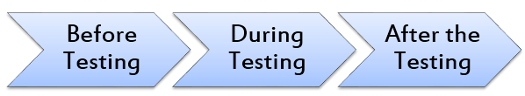
Test deliverables are provided before testing phase
Test plans document, Test cases documents, Test Design specifications.
During T: Test Scripts, Simulators, Test Data, Test Traceability Matrix, Error logs and execution logs
After T: Test Results/reports, Defect Report, Installation/ Test procedures guidelines, Release notes

Slide 21
Test Management Phases
There are two main Parts of Test Management Process:
Planning :
Risk Analysis,
Test Estimation,
Test Planning,
Test Organization
Execution :
Test Monitoring and Control,
Issue Management,
Test Report and Evaluation

Slide 22
Risk Analysis
Risk is the potential loss (an undesirable outcome, however not necessarily so) resulting from a given action or an activity.
Risk Analysis is the first step which Test Manager should consider before starting any project.
Early risk detection and identification of its solution will help Test Manager to void potential loss in the future & save on project cost.

Slide 23
Test Estimation
An estimate is a forecast or prediction.
Test Estimation is approximately determining how long a task would take to complete.
Estimating effort for the test is one of the major and important tasks in Test Management.
Benefits of correct estimation:
Accurate test estimates lead to better planning, execution and monitoring of tasks under a test manager's attention.
Allow for more accurate scheduling and help realize results more confidently

Slide 24
Test Planning
A Test Plan can be defined as a document describing the scope, approach, resources, and schedule of intended Testing activities.
A project may fail without a complete Test Plan. Test planning is particularly important in large software system development.
In software testing, a test plan gives detailed testing information regarding an upcoming testing effort, including:
Test Strategy
Test Objective
Exit /Suspension Criteria
Resource Planning
Test Deliverables

Slide 25
Test Organization
how will you stick to the plan and execute it? To answer that question, you have Test Organization phase.
Generally speaking, you need to organize an effective Testing Team. You have to assemble a skilled team to run the ever-growing testing engine effectively.

Slide 26
Test Monitoring and Control
Monitoring is a process of collecting, recording, and reporting information about the project activity that the project manager and stakeholder needs to know
To Monitor, Test Manager does following activities
Define the project goal, or project performance standard
Observe the project performance, and compare between the actual and the planned performance expectations
Record and report any detected problem which happens to the project

Slide 27
Test Monitoring and Control
Controlling
Project Controlling is a process of using data from monitoring activity to bring actual performance to planned performance.
In this step, the Test Manager takes action to correct the deviations from the plan. In some cases, the plan has to be adjusted according to project situation

Slide 28
Issue Mgmt: When the risk happens, it becomes an issue.
Risk to be avoided while testing:
Missing the deadline
2. Exceed the project budget
3. Lose the customer trust

Slide 29
Test Report and Evaluation :
Test Evaluation Report” describes the results of the Testing in terms of Test Coverage and exit criteria.
The data used in Test Evaluation are based on the test results data and test result summary.

Slide 30
Test Report & Evaluation
purpose of the Test Evaluation Reports is:
“Test Evaluation Report” describes the results of the Testing in terms of Test Coverage and exit criteria.
The data used in Test Evaluation are based on the test results data and test result summary.

Slide 31
Test Management Process
is a set of activities from the start of the testing to the end of the testing.
Test process provides the facility to plan and control the testing throughout the project cycle.
It helps to track and monitor the testing throughout the project.

Slide 32
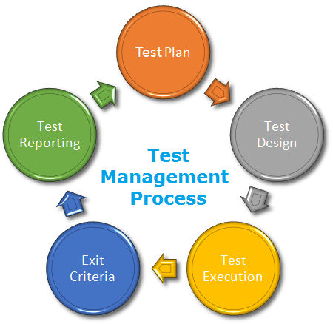
Test Management Process

Slide 33
Test plan
Test plan served as an initial sketch to carry out the testing.
Testing is being tracked and monitored as per the test plan.
explains the over view of particular requirement which needs to be tested, scope, functional and non-functional requirement, risk and mitigation, testing approaches, test schedule

Slide 34
Test Design
Test design affords how to implement the testing
Two types of test design techniques
static testing : test without execution mostly to artifacts like document
dynamic testing: testing by executing the system

Slide 35
Test case (Element in test case document):
Project / Test title, Test executed by, Test executed date, Version of the software and Test environment
Test case number
Test summary
Steps
Pre-condition
Post condition
Test data
Actual result
Expected result
Test result
Note

Slide 36
Test Execution
Test the actual system result against the expected result is test execution.
Test execution can be done manually and by using automation suit
Example for static testing:
Test the requirement specification document.
Test the design document
Test the user guide
Example for dynamic testing:
Unit testing
Functional testing
Integration testing

Slide 37
Exit Criteria
Determines when to stop the test execution.
Exit criteria is defined during the test plan phase and used in the test execution phase as a mile stone. some common exit criteria
All critical defects are closed.
All the reported defects are closed and verified.
Executed and covered the areas which used by user mostly.
System catered all the requirements.
All the important functions are tested and working as expected.

Slide 38
Test Reporting:
Test report is prepared and communicated periodically like daily, weekly, month etc.
Test coverage report: (Elements of test coverage report)
Percentage completed
Test scenario
Software area
Tested resource
Tested date
Test result

Slide 39
Defect summary report: (Elements of defect summary report)
Defect by severity
Defects by priority
Defects by assigned developer
Defects by function
Defects by software area
Open and closed defects

Slide 40
Risk and mitigation report: (Elements of risk and mitigation report)
Identified risk
Likelihood- described as frequency values or with respect to how easy it is for a person to exploit a threat.
Risk level
Risk type
Mitigation plan

Slide 41
Severity and priority
These two things we have to choose once the bug is found.
Whenever we find a bug, we select the bug severity and bug priority.
Testers select the severity of the bug
The Project Manager or Project Lead selects the bug priority.

Slide 42
Bug/Defect severity can be defined as the impact of the bug on the application.
It can be Critical, Major or Minor.
Critical:
A critical severity issue is an issue where a large piece of functionality or major system component is completely broken and there is no workaround to move further. For example, Due to a bug in one module, we cannot test the other modules because that blocker bug has blocked the other modules.

Slide 43
Major:
A major severity issue is an issue where a large piece of functionality or major system component is completely broken and there is a workaround to move further.
Minor:
A minor severity issue is an issue that imposes some loss of functionality, but for which there is an acceptable & easily reproducible workaround.
For example, font family or font size or color or spelling issue
Trivial:
A trivial severity defect is a defect which is related to the enhancement of the system

Slide 44
Priority
Defect priority can be defined as an impact of the bug on the customers business.
Main focus on how soon the defect should be fixed. It gives the order in which a defect should be resolved.
Developers decide which defect they should take up next based on the priority.
It can be High, Medium or Low.

Slide 45
High:
A high priority issue is an issue which has a high impact on the customers business or an issue which affects the system severely and the system cannot be used until the issue was fixed.
These kinds of issues must be fixed immediately.
The priority of the issue is set to high priority even though the severity of the issue is minor.
Medium:
Issues which can be released in the next build comes under medium priority. Such issues can be resolved along with other development activities.
Low:
An issue which has no impact on the customer business comes under low priority.

Slide 46
Development team takes up the high priority defects first rather than of high severity
Severity is assigned by Tester / Test Lead & priority is assigned by Developer/Team Lead/Project Lead.
Selection of severity and priority may vary depends on project and organization.
In Gmail, composing an email is main functionality, whereas composing an email feature in a banking (email option to send emails internally) application is not the main functionality.

Slide 47
BUG Report
Defect_ID - Unique identification number for the defect.
Defect Description - Detailed description of the Defect including information about the module in which Defect was found.
Version - Version of the application in which defect was found.
Steps - Detailed steps along with screenshots with which the developer can reproduce the defects.
Date Raised - Date when the defect is raised
Reference- where in you Provide reference to the documents like . requirements, design, architecture or maybe even screenshots of the error to help understand the defect
Detected By - Name/ID of the tester who raised the defect
Status - Status of the defect , more on this later
Fixed by - Name/ID of the developer who fixed it
Date Closed - Date when the defect is closed
Severity which describes the impact of the defect on the application
Priority which is related to defect fixing urgency. Severity Priority could be High/Medium/Low based on the impact urgency at which the defect should be fixed respectively

Slide 48
Test Process
Testing is a process rather than a single activity
This process starts from test planning then designing test cases,
preparing for execution and evaluating status till the test closure.
divide the activities within the following basic steps:
Planning and Control
Analysis and Design
Implementation and Execution
Evaluating Exit Criteria and Reporting
Test Closure activities

Slide 49
Test planning
Test planning has following major tasks: i. To determine the scope and risks and identify the objectives of testing. ii. To determine the test approach. iii. To implement the test policy and/or the Test strategy which is an outline that describes the testing portion of the S/w Development cycle

Slide 50
Test planning
iv. To determine the required test resources like people, test environments, PCs, etc.
v. To schedule test analysis and design tasks, test implementation, execution and evaluation.
vi. To determine the Exit criteria we need to set criteria such as Coverage criteria. (Coverage criteria are the percentage of statements in the software that must be executed during testing.

Slide 51
Test control has the following major tasks: i. To measure and analyze the results of reviews and testing.
ii. To monitor and document progress, test coverage and exit criteria.
iii. To provide information on testing.
iv. To initiate corrective actions.
v. To make decisions.

Slide 52
Analysis and Design:
Test analysis and Test Design has the following major tasks: i. To review the test basis. (The test basis is the information we need in order to start the test analysis and create our own test cases. Basically it’s a documentation on which test cases are based, such as requirements, design specifications, product risk analysis, architecture and interfaces.

Slide 53
We can use the test basis documents to understand what the system should do once built.
ii. To identify test conditions. iii. To design the tests. iv. To evaluate testability of the requirements and system. v. To design the test environment set-up and identify and required infrastructure and tools.

Slide 54
Implementation and Execution:
Test execution has the following major task:
i. To execute test suites and individual test cases following the test procedures.
ii. To re-execute the tests that previously failed in order to confirm a fix. This is known as confirmation testing or re-testing.

Slide 55
iii. To log the outcome of the test execution and record the identities and versions of the software under tests. The test log is used for the audit trial. (A test log is nothing but, what are the test cases that we executed, in what order we executed, who executed that test cases and what is the status of the test case (pass/fail). iv. To Compare actual results with expected results. v. Where there are differences between actual and expected results, it report discrepancies as Incidents.

Slide 56
Evaluating Exit criteria and Reporting:
Based on the risk assessment of the project , criteria vary from project to project and are known as exit criteria. Exit criteria come into picture, when: — Maximum test cases are executed with certain pass percentage. — Bug rate falls below certain level. — When achieved the deadlines.

Slide 57
Evaluating exit criteria has the following major tasks: i. To check the test logs against the exit criteria specified in test planning. ii. To assess if more test are needed or if the exit criteria specified should be changed. iii. To write a test summary report for stakeholders.

Slide 58
Test Closure activities:
Test closure activities are done when software is delivered. Other reasons for the testing can be closed are:
When all the information has been gathered which are needed for the testing.
When a project is cancelled.
When some target is achieved.
When a maintenance release or update is done.

Slide 59
Test closure activities have the following major tasks: i. To check which planned deliverables are actually delivered and to ensure that all incident reports have been resolved. ii. To finalize and archive testware such as scripts, test environments, etc. for later reuse. iii. To handover the testware to the maintenance organization. They will give support to the software. iv To evaluate how the testing went and learn lessons for future releases and projects

